Slide 1


Slide 2
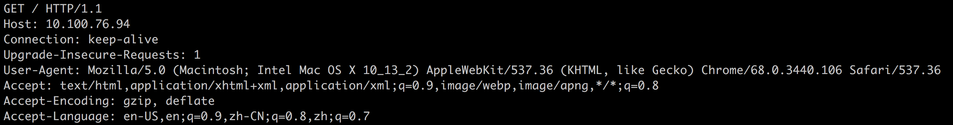
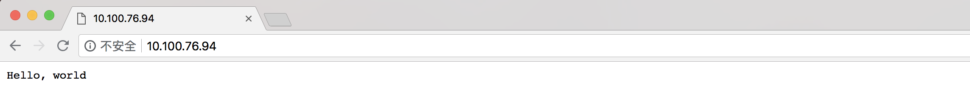
http server

Slide 3
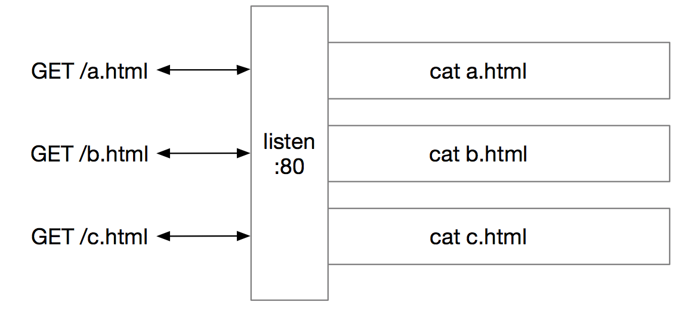
http server

Slide 4
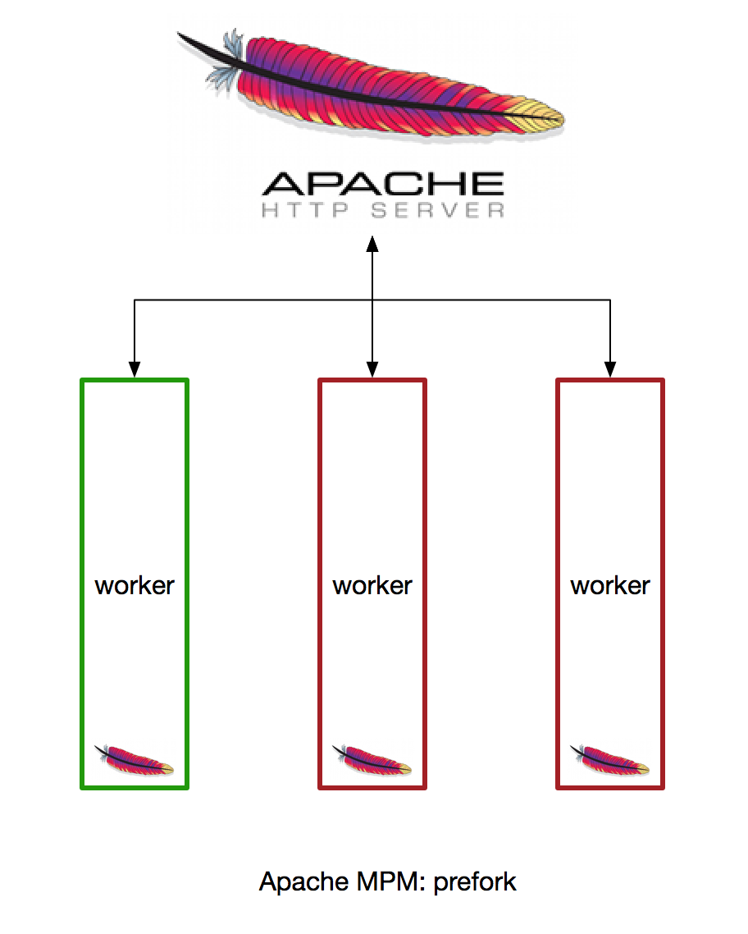
http server

Slide 5
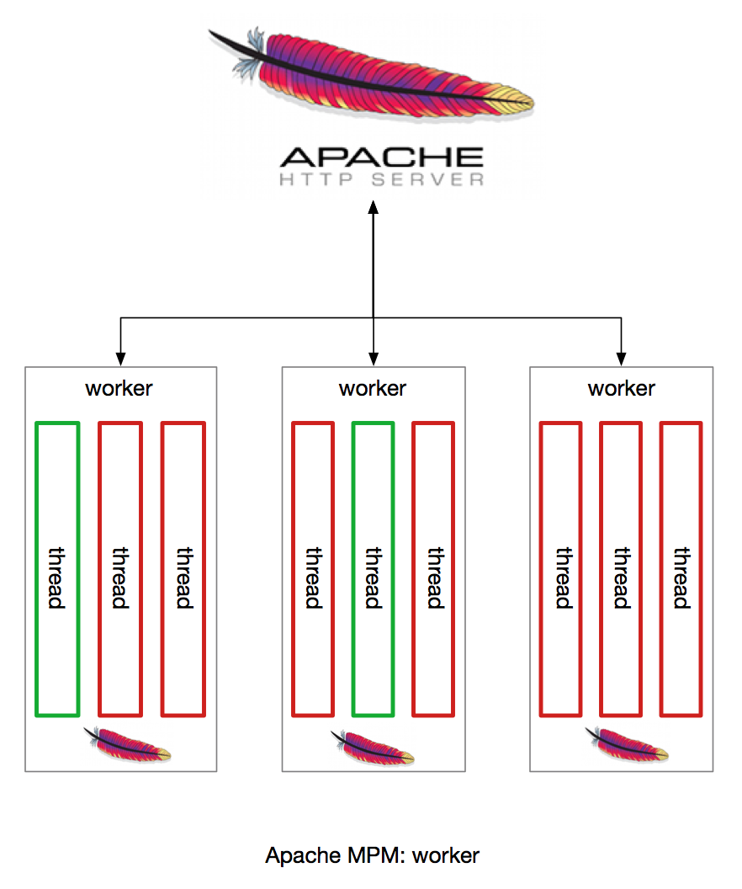
http server
+thread

Slide 6
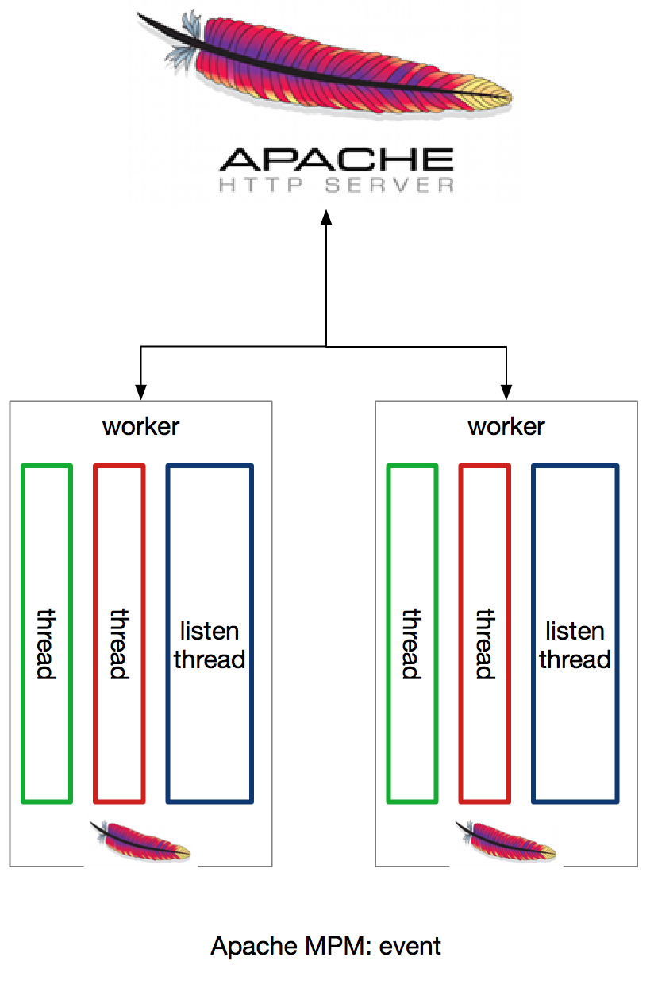
http server
httpd-2.2 @ 2006
httpd-2.4 @ 2012
+epoll
Notes:
linux 2.6@2004
nginx 0.1.0 @2004.10.04

Slide 7
http server

Slide 8
http server
LAMP
LNMP

Slide 9
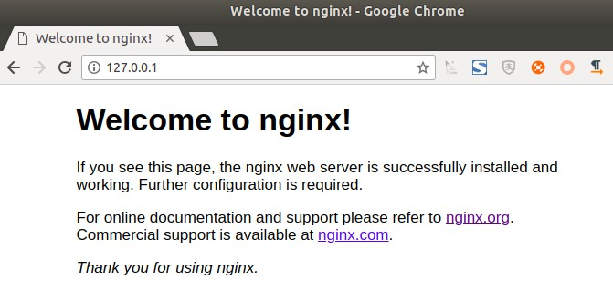
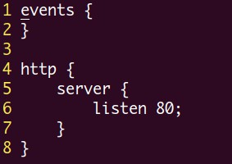
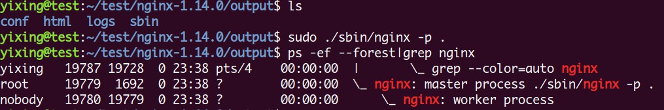
nginx
3
test
1
nginx.conf
2
start

Slide 10
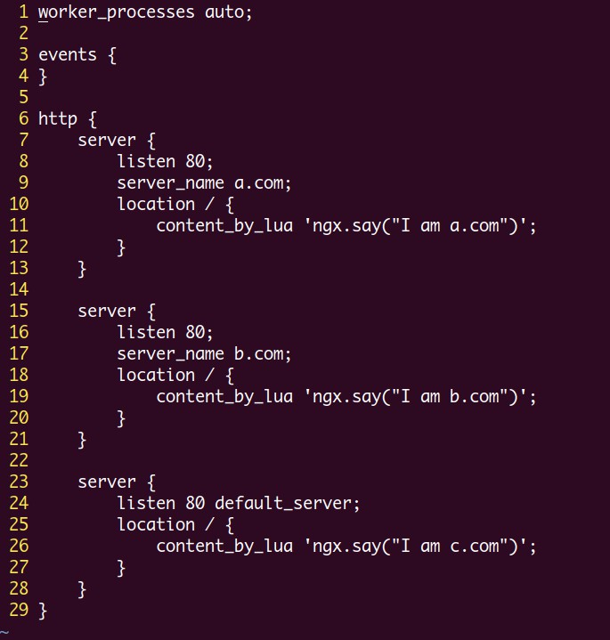
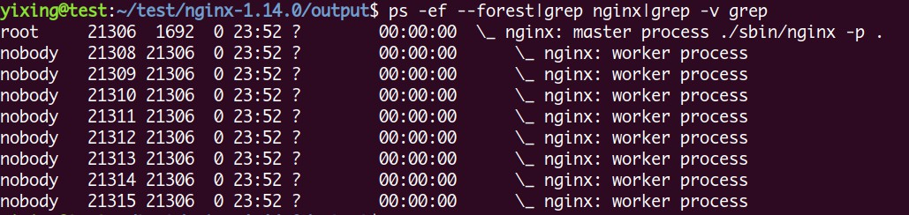
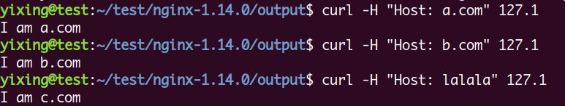
nginx

Slide 11
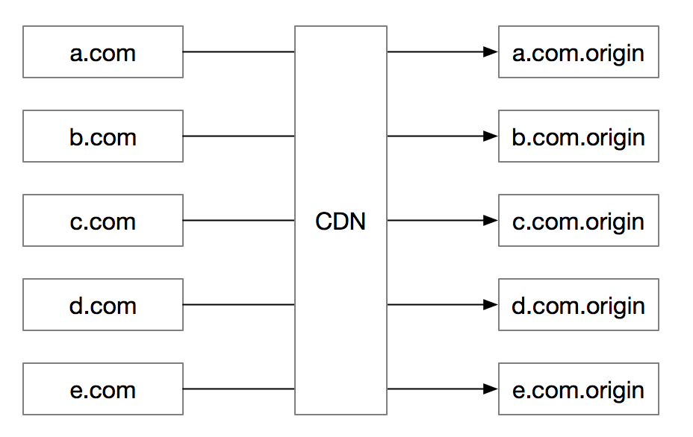
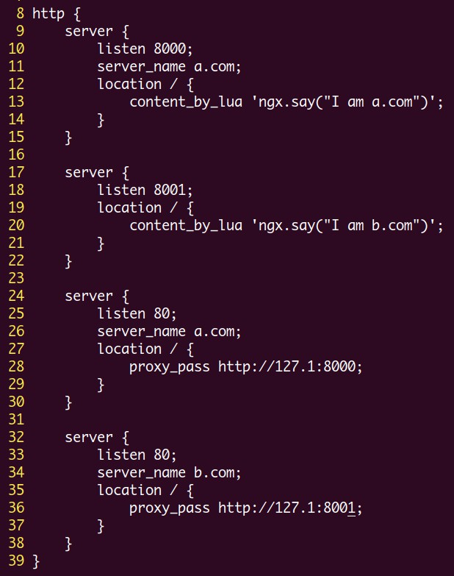
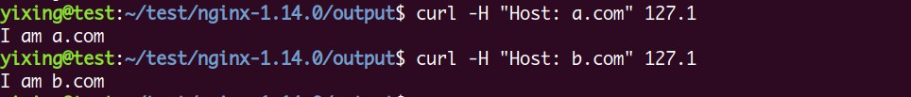
nginx

Slide 12
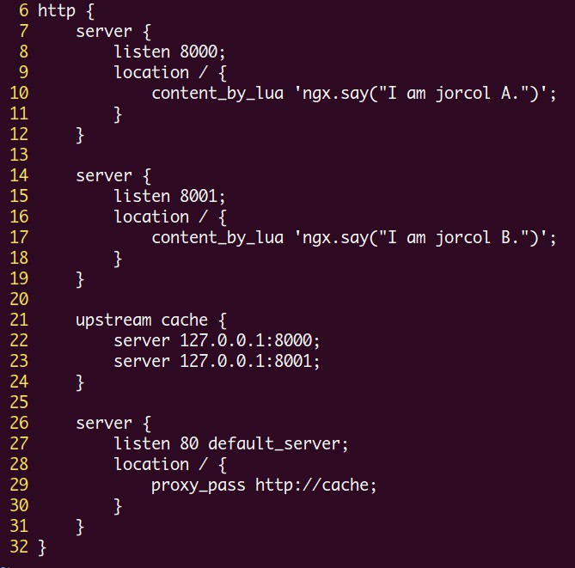
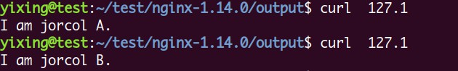
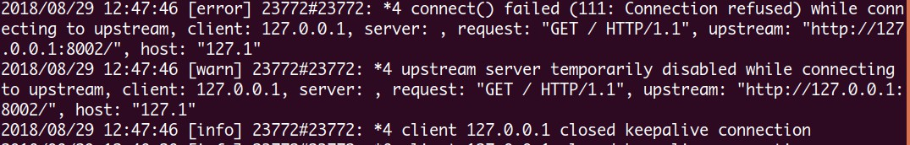
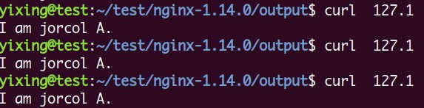
nginx

Slide 13
nginx

Slide 14
nginx
海量域名
upstream健康检查
一致性hash
热点打散
billing流量统计
ACL访问控制
定制化

Slide 15
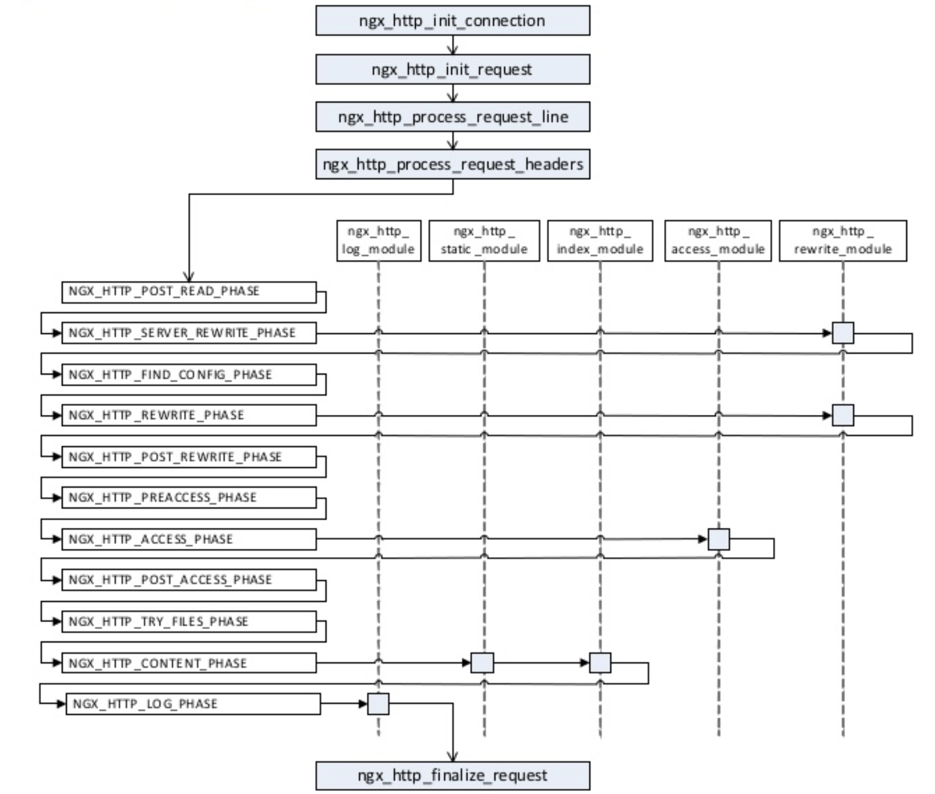
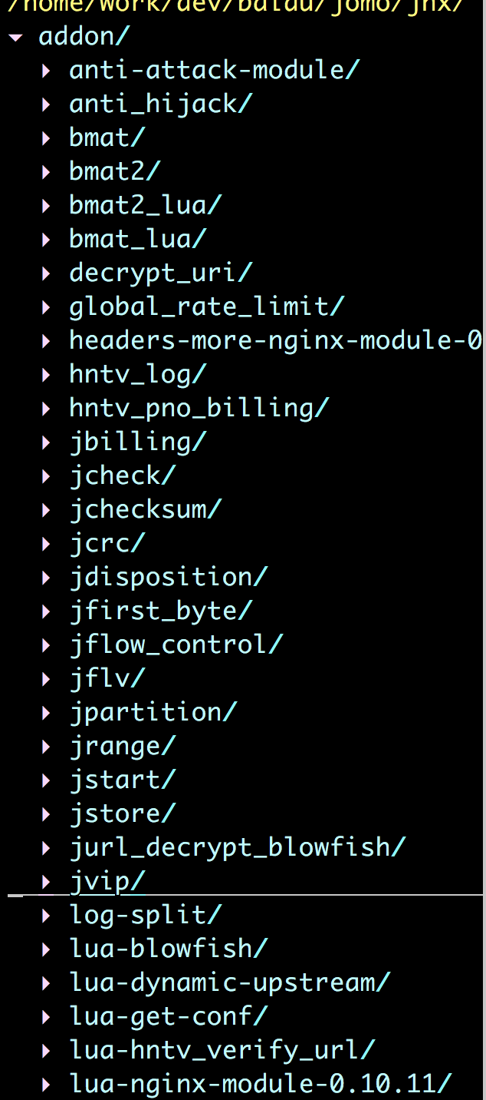
nginx
Notes:
post_read_by_lua

Slide 16
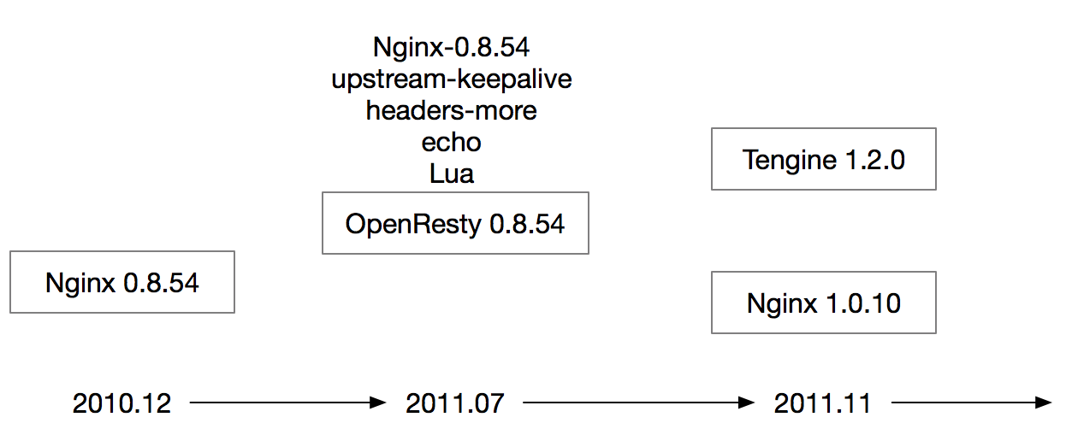
nginx

Slide 17
nginx
server {
listen 7023 ssl http2 backlog=4096;
ssl_certificate_by_lua_file shared_cert_pkey_choose.lua;
access_by_lua_file 'lua/opencdn/access_filter.lua';
rewrite_by_lua_file 'lua/opencdn/rewrite_filter.lua';
header_filter_by_lua_file 'lua/opencdn/header_filter.lua';
body_filter_by_lua_file 'lua/opencdn/body_filter.lua’;
proxy_pass $upstream_schema://$upstream_name;
…
Notes:
post_read_by_lua

Slide 18
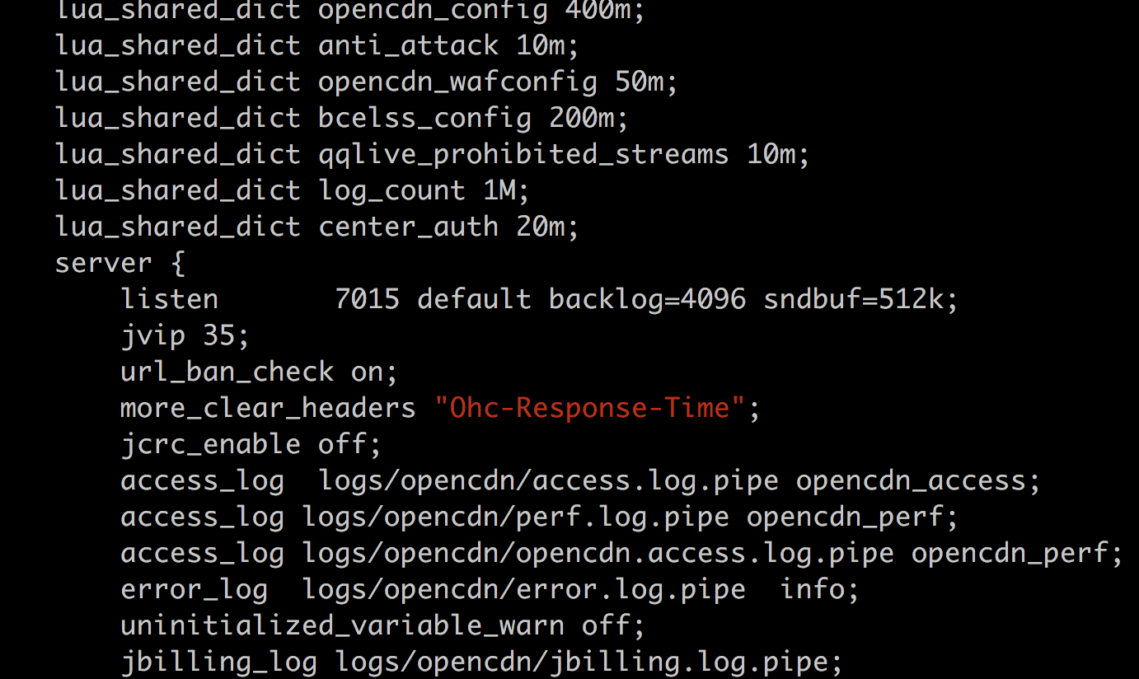
nginx

